Slide 1

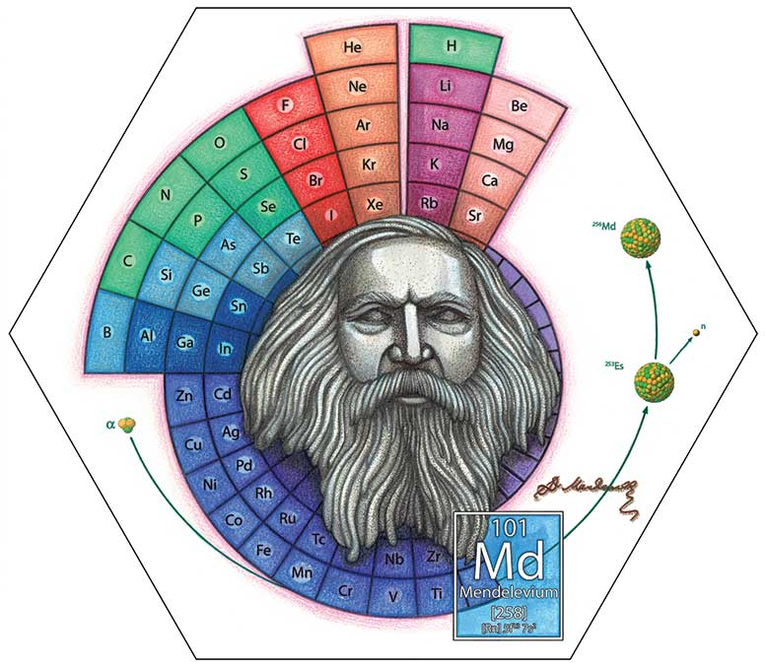
Faculty of Chemical Engineering Department of Inorganic Technology
General Chemistry
Chapter 2
Periodic Table and Properties
150th year anniversary of the periodic table (1869 - 2019), UNESCO commented: “the periodic table of chemical elements is universe window, helping to explain our understanding of the world around us”.
Dimitri Mendeleyev

Slide 2
Outline
1. Periodic Table Timeline
1.1. Mendeleyev Theory
1.2. Quantum Mechanic Theory
2. Periodic-table Structure
2.1. The rules of element arrangement
2.2. Periodic-table Structure
3. Trends in Periodic Table
3.1. General Properties
3.2. Atomic Radius
3.3. Ionization Energy
3.4. Electron Affinity
3.5. Electronegativity
4. Valence – Oxidation No.

Slide 3
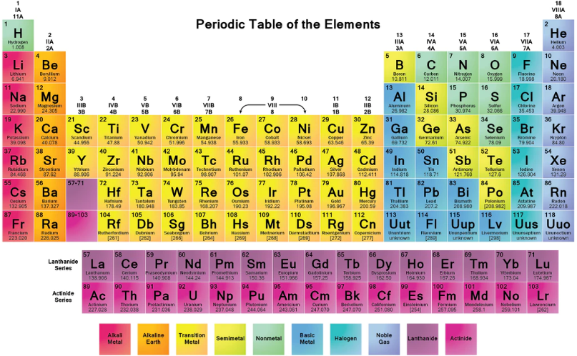
What is the periodic table?
The periodic table is a chart of elements arranged into rows and columns based on their physical and chemical properties.
It can be used to determine the relationships among the elements.
How are elements arranged on the periodic table?

Slide 4
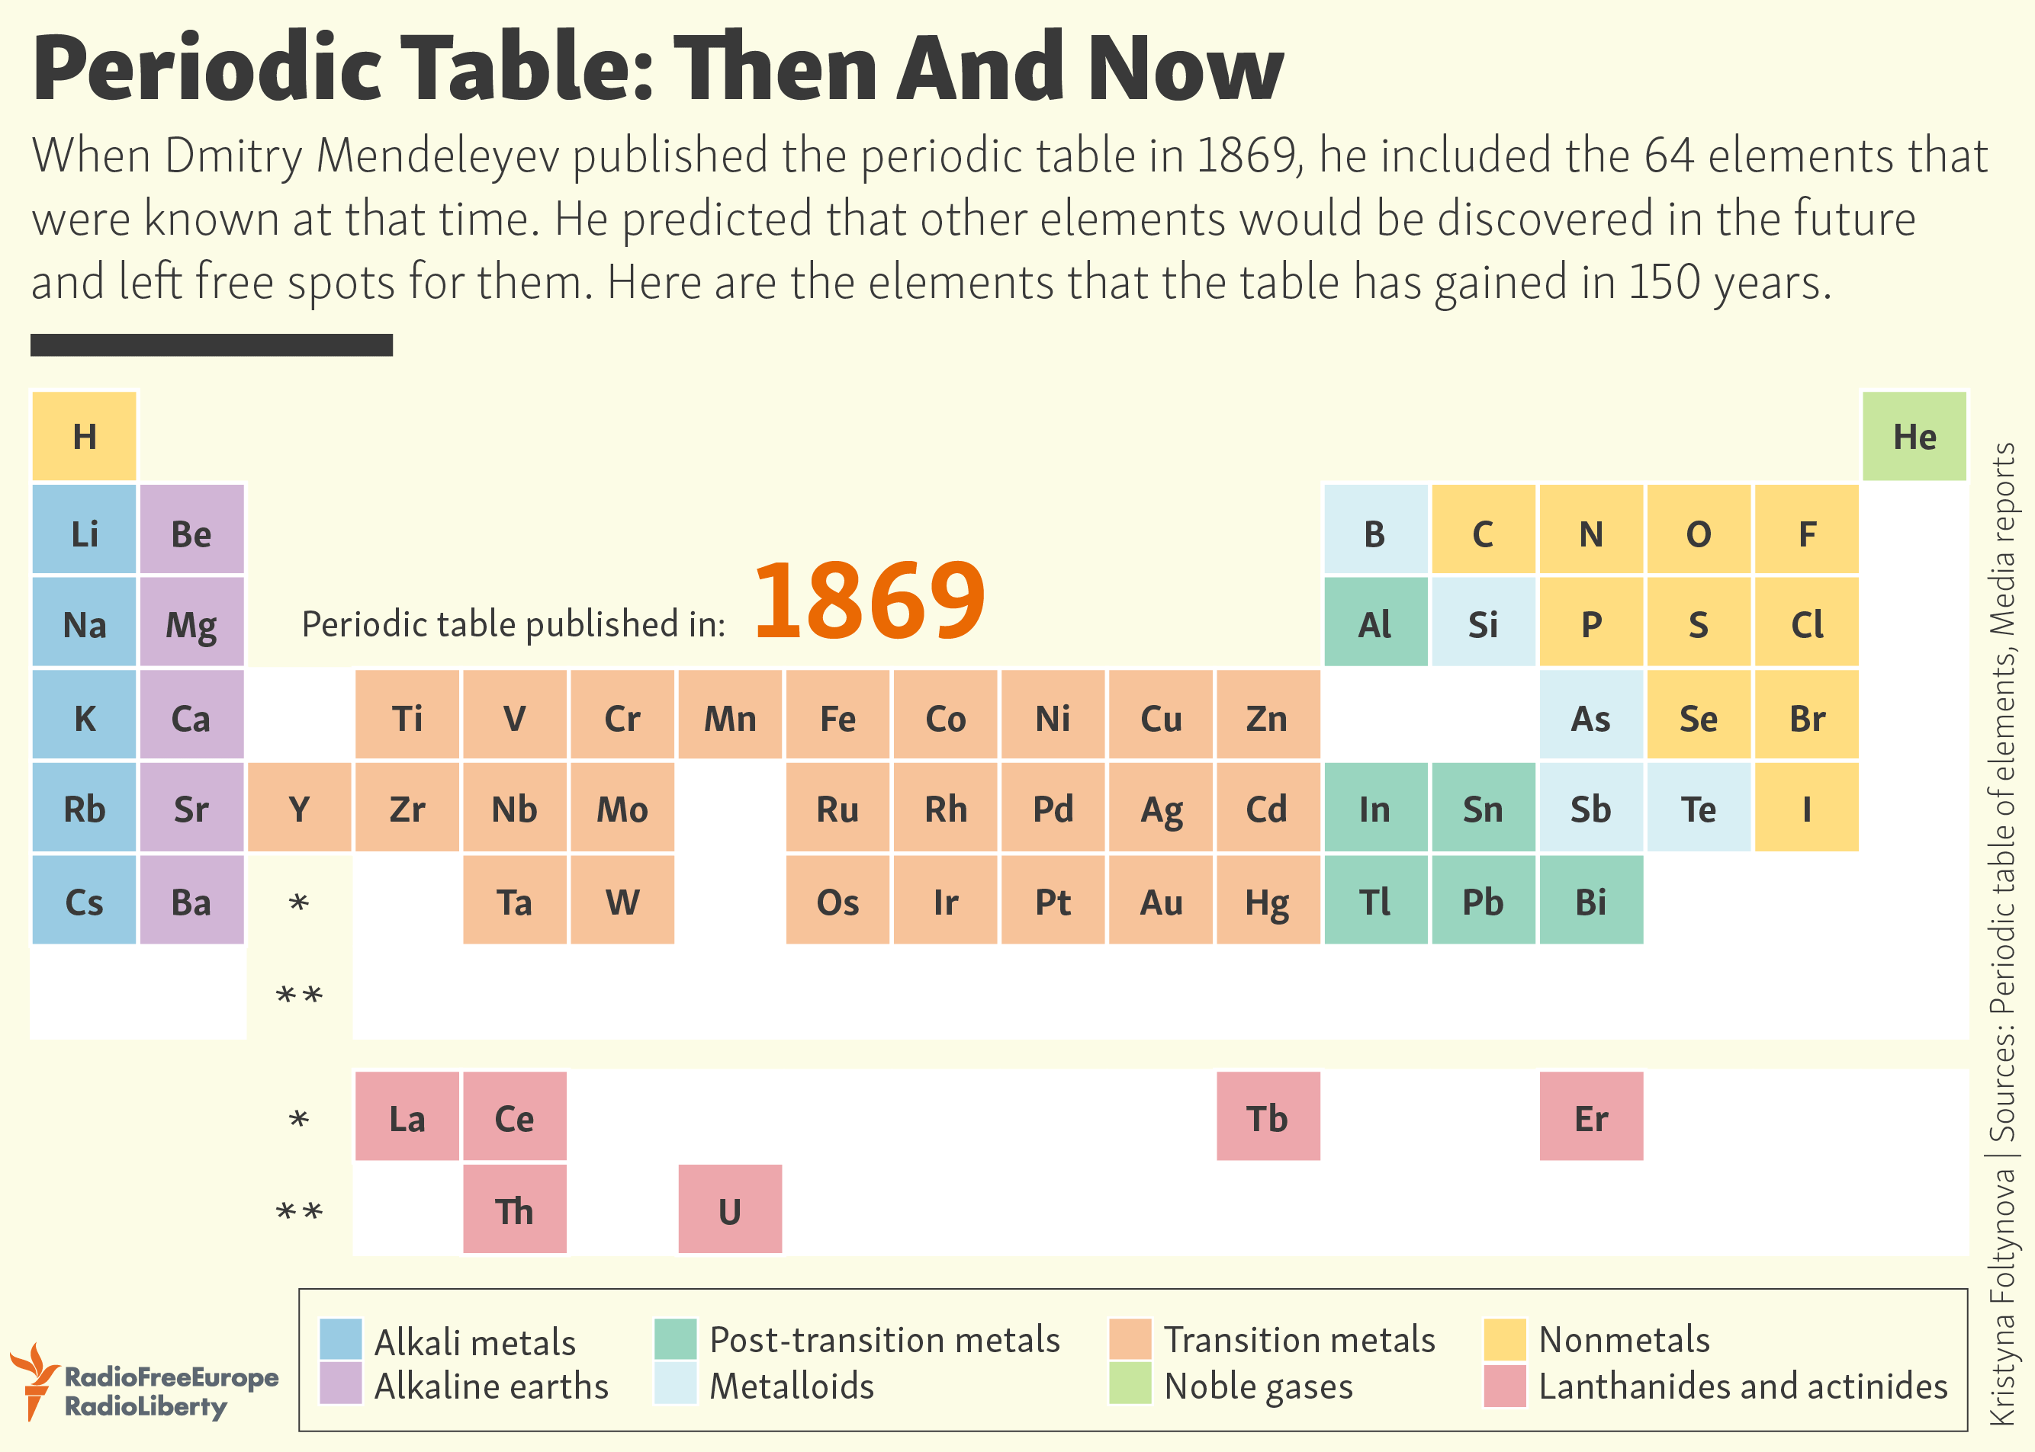
Periodic Table Timeline
Mendeleev Theory
Arranged elements in periodic table with increasing the order of atomic mass.
Quantum Mechanic Theory
The properties of elements as well as compounds of chemical elements change periodically with increasing atomic number.
The Periodic Table has 118 elements.

Slide 5
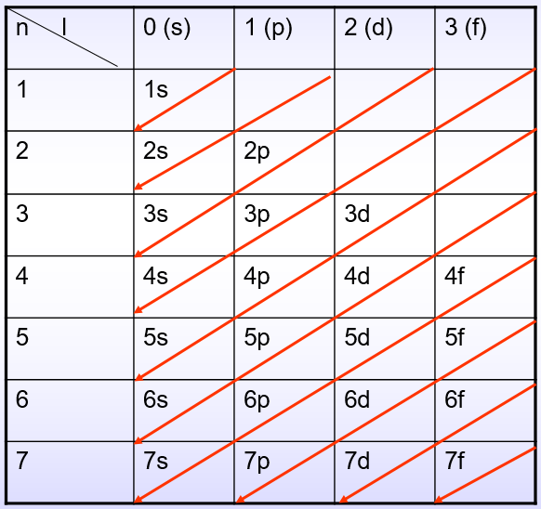
Electron’s Arrangement in Periodic Table
Periods: Metals ⇢ Non metal ⇢ Noble gas
(Exception Period 1 (H, He))
Groups: Same VEs ⇢ Similar Properties
1A: Alkaline M.; 2A: Alkaline Earth M.; 7A: Halogen; 8A: Noble gas

Slide 6
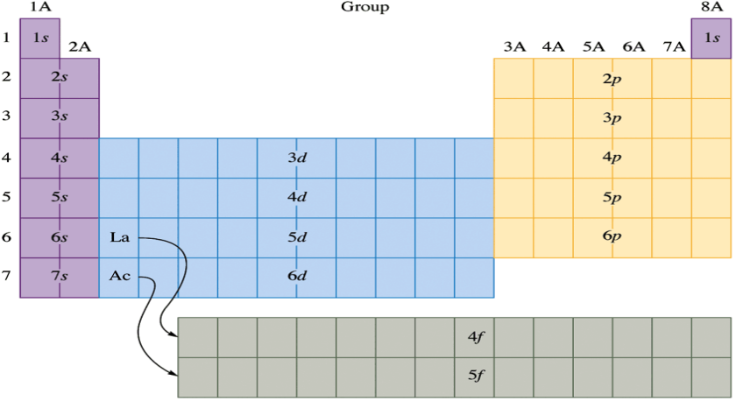
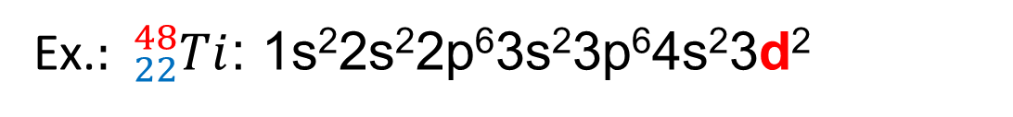
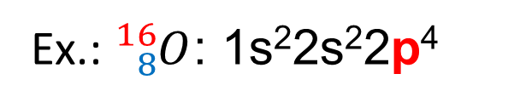
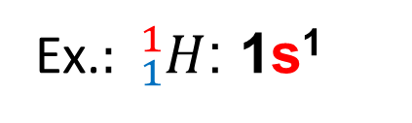
Elemental Family
Elemental Family: is the AO name having electrons on the final subshell
1. s-family (ns^{1,2}):
Conclusion:
Ex.$: {}_{1}^{1}H$: 1s¹
ns¹⁻² : s-family
2. p-family (ns²np¹⁻⁶):
ns²np¹⁻⁶ : p-family
ns²(n-1)d¹⁻¹⁰ : d-family
Ex.: ${}_{8}^{16}O$: 1s²2s²2p⁴
ns²(n-2)f¹⁻¹⁴ : f-family
3. d-family ‹ns²(n-1)d¹⁻¹⁰›
Ex.$: {}_{22}^{48}{Ti}$: 1s²2s²2p⁶3s²3p⁶4s²3d²
4. f-family: (n-2)f¹⁻¹⁴:
4f¹⁻¹⁴: Lanthanide
5f¹⁻¹⁴: Actinide

Slide 7
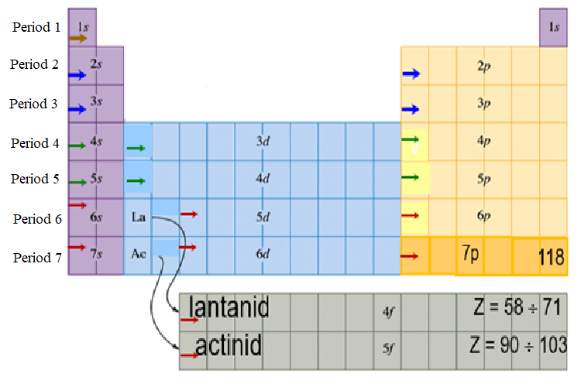
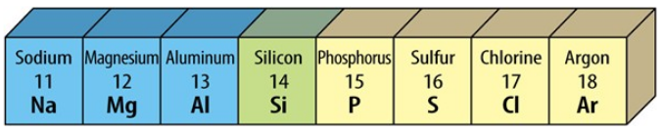
Periodic Structure (Periods – Groups)
Periods: are the rows on the periodic table.
There are 7 periods (3 small + 4 big periods)
Properties: Elements in the same period have the similar outermost shell.
Period Number = Maximum Shell (n_{max})
Periods |  | Elements | No.
Small | 1 | 2 s-elements | 2
 | 2 | 2 s-elements + 6 p-elements | 8
 | 3 |  | 8
Big | 4 | 2 s-elements + 10 d-elements + 6 p-elements | 18
 | 5 |  | 18
 | 6 | 2 s-elements + 10 d-elements + 6 p-elements + 14 f-elements | 32
 | 7 |  | 32
Total elements |  |  | 118
3s¹
3s²
3s²3p¹
3s²3p²
3s²3p³
3s²3p⁴
3s²3p⁵
3s²3p⁶
P. 3
n_{max} =3
Metals ⇢ Non Metals ⇢ Inert gas
(Exception Period 1 (H, He))

Slide 8
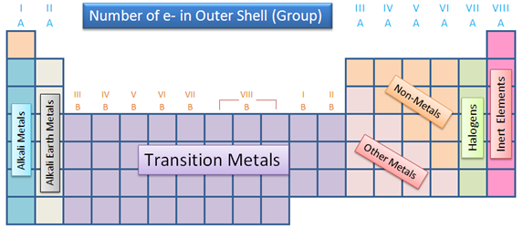
Periodic Structure (Periods – Groups)
Groups: are the columns on the periodic table.
There are 18 groups (8A + 8B groups)
Properties: Elements in the same group have the similar valence electrons → similar properties.
Group name:
A Groups (s,p-elements: nsªnp^{b}) = a + b
Some of the groups in the periodic table are given special names:
B Groups: (d-elements): ns^{c}(n-1)d^{d}
if: d < 6: B-group No. = c + d;
d = 6 - 8: B-group No. = 8;
d = 10: B-group No. = c

Slide 9
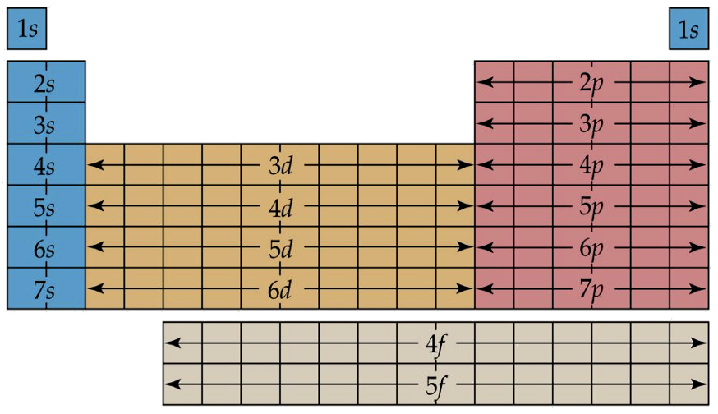
A Groups (1A – 8A) s- and p-elements
The A groups contain elements in which s and p orbitals are being filled.
The valence-shell configuration of nsª: s-element
The valence-shell configuration of ns²np^{b}: p-element
The valence-shell configuration of main group is nsªnp^{b}:
Group number = a+b.
Valence Shell | ns¹ | ns² | ns²np¹ | ns²np² | ns²np³ | ns²np⁴ | ns²np⁵ | ns²np⁶
A Groups | 1A | 2A | 3A | 4A | 5A | 6A | 7A | 8A

Slide 10
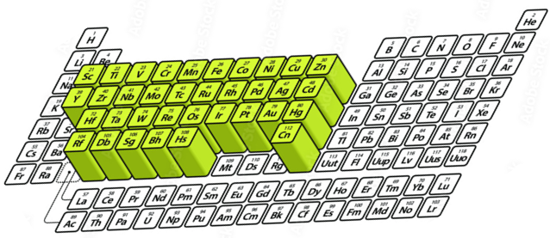
B Groups (1B – 8B) d- and f-elements
3B
8B
B Group | d-elements
IB | ns¹(n-1)d¹⁰
IIB | ns²(n-1)d¹⁰
IIIB | ns²(n-1)d¹
IVB | ns²(n-1)d²
VB | ns²(n-1)d³
VIB | ns¹(n-1)d⁵
VIIB | ns²(n-1)d⁵
VIIIB | ns²(n-1)d^{6,7,8}
4B
5B
6B
7B
1B
2B
The B groups contain d & f-family elements classified into 8 subgroups (1B-8B)
Elements in the B groups are known as the transition elements or transition metals.
All 28 f-element metals including Lathanide family (6s²4f¹⁻¹⁴) and Actinide family (7s²5f¹⁻¹⁴) are located in Group 3B.

Slide 11
Summary
118 elements are arranged in Periodic Table in the order of ascending Z↑
In Periodic Table, 7 periods and 18 groups (8A+8B, 3 subgroups in 8B group)
Period (row): has the n_{max} = const. and periodical-property changes
Metal ⇢ Non metal ⇢ Noble gas
3 small periods + 4 big periods
Period number = n_{max} (n^{th} shell of outermost shell)
Group (column): has same valence electrons → same properties
A Group (1-8A) s & p-element with e⁻ configuration: ns^{1,2}np¹⁻⁶;
B Group (1-8B) d-elements with ns^{1,2}(n-1)d¹⁻¹⁰; f-elements with ns^{1,2}(n-2)f¹⁻¹⁴
Group number = valence electrons.

Slide 12
Practices – Determine the element positions
Problem: Atomic Number (Z) given
- Figure out n_{max} = Period No.
⇢ Write E_{n}
- Figure out valence electrons
A-Group No. (s,p-elements: nsªnp^{b}) = a + b
B-Group No. (d,f-elements): ns^{c}(n-1)d^{d}
if: d < 6: B-group No. = c + d;
d = 6 - 8: B-group = 8, d = 10: B-group = c

Slide 13
Practices – Determine the element positions
Example 1:
Z | Energy Configuration | Valence electron | Family | Period | Groups | Elements
Z = 16
1s²2s²2p⁶3s²3p⁴
3s²3p⁴
p
3
6A
S
Z = 25
1s²2s²2p⁶3s²3p⁶4s²3d⁵
4s²3d⁵
d
4
7B
Mn
Z = 35
1s²2s²2p⁶3s²3p⁶4s²3d¹⁰4p⁵
4s²4p⁵
p
4
7A
Br
Z = 3
1s²2s¹
2s¹
s
2
1A
Li
Z = 29
1s²2s²2p⁶3s²3p⁶4s¹3d¹⁰
4s¹3d¹⁰
d
4
1B
Cu

Slide 14
Practices – Determine the element positions
Example 2: The position of element in periodic table has the electron structure 1s²2s²2p⁶3s²3p⁶3d⁵4s² Is:
A. Period 4, group VIIB, cell 23 B. Period 4, group VIIB, cell 25
C. Period 4, group VIIA, cell 25 D. Period 4, group VB, cell 25
Example 3: Choose the correct statements. Electron structure of 2 elements of group VIB and VIA of period 4 is, respectively:
1) 1s²2s²2p⁶3s²3p⁶3d⁴4s² 2) 1s²2s²2p⁶3s²3p⁶3d⁵4s¹
3) 1s²2s²2p⁶3s²3p⁶3d¹⁰4s²4p⁴ 4) 1s²2s²2p⁶3s²3p⁶3d¹⁰4s¹4p⁵
a) 1, 3 b) 2, 3 c)1, 4 d) 2, 4

Slide 15
Practices – Determine the element positions
Example 4: Find the element in periodic table corresponding to the final electron of (n, l, m_{l}, m_{s}) = (3, 2, -2, -1/2)
A. Z = 24, Cr B. Z = 25, Mn
C. Z= 26, Fe D. Z = 27, Co
⇢ Final subshell: 3d ⇢ ⇢ 3d⁶ ⇢ 4s²3d⁶
↑↓
↑
↑
↑
↑
-2
-1
0
+1
+2
⇢ Family: d, Period 4, Group: 8B, Z = 26 ⇢ Fe

Slide 16
Practices – Determine the element positions
Example 5: Find the elements from their ions:
1. A²⁺ cation has a final subshell of 3d⁵
⇢ A: 4s²3d⁵ ⇢ Z = 25 ⇢ Mn
2. X³⁻ anion has a last subshell of 2p⁶
⇢ X: 2s²2p³ ⇢ Z = 7 ⇢ N

Slide 17
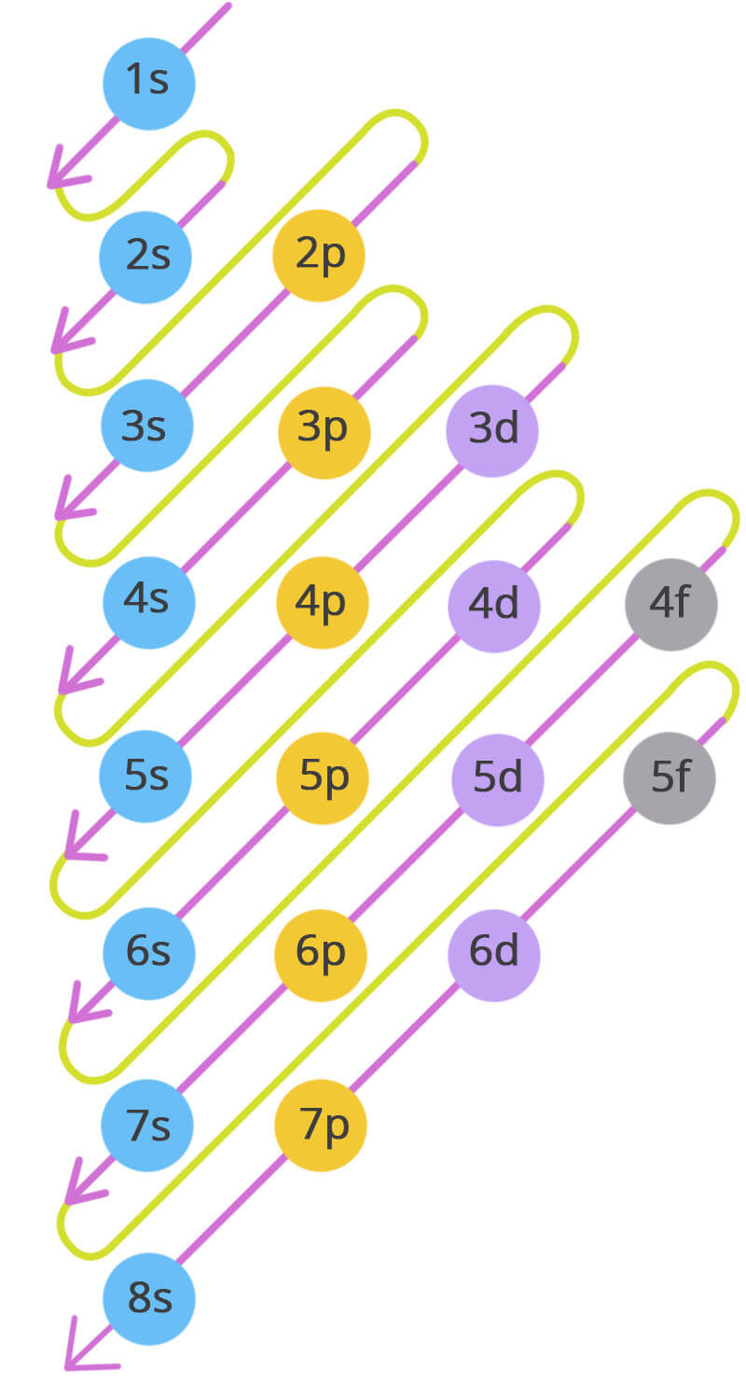
Practices – Determine the element positions
Example 6:
Choose the CORRECT statement. According to the arrangement rule of the periodic table, please predict the Z value of an halogen element (Group 7A) in Period 8.
A. 125 B. 158
C. 167 D. 162
118

Slide 18
Trends and the Periodic Properties
General Property
Atomic Radius
Ionization Energy
Electron Affinity
Electronegativity
n value
Z values, VEs

Slide 19
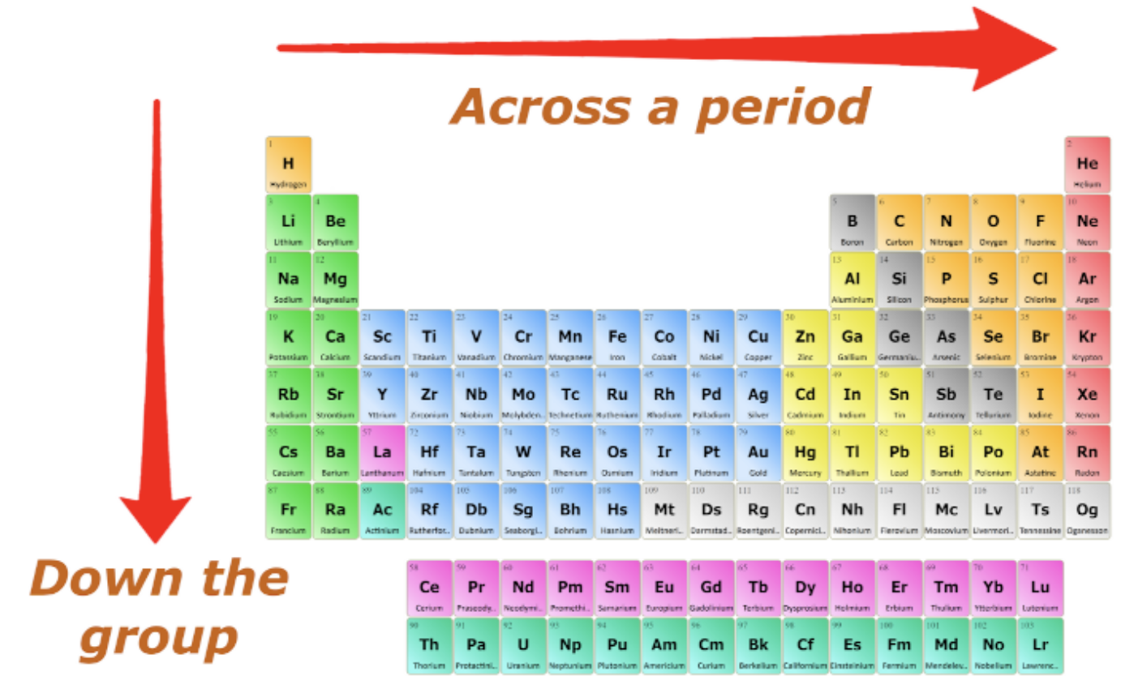
General Properties
PERIODS: left to right across a period:
n = const, but Z ↑ → Increase the attraction of nucleus and outermost electrons → Increase electron acceptance.
Metallic property ↓
Non-metallic property ↑
Groups: top to bottom down a group
VE = const, but n ↑ → Decrease the attraction of nucleus and outermost electrons → Increase electron donation.
Metallic property ↑
Non-metallic property ↓

Slide 20
General Properties
Example: In these following statements, the incorrect statement is:
In the same period in order from left to right, we have:
1) Electron layer increases. 2) Non-metallic decreases.
3) The metalicity increases. 4) Non-metallic increases.
A. 1,2,4 B. 4 C. 1 D. 1,2,3

Slide 21
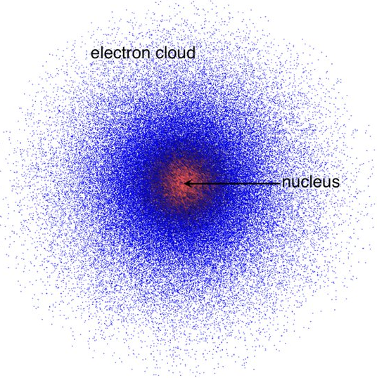
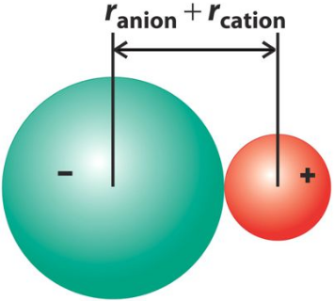
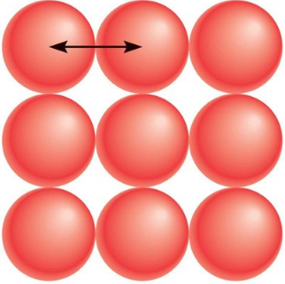
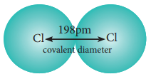
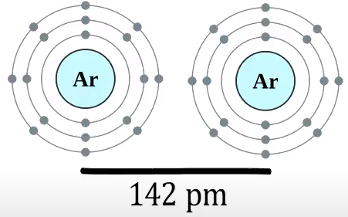
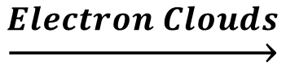
Atomic Radius
$$\underset{→}{Electron Clouds}$$
Difficult to calculate exactly
either atomic or ion radius
→ Effective Radius
(r)
RADIUS (r): is determined based on the distance between the two atoms that make up the respective compound
Classification:
Metallic Radius
Covalence Radius
Ionic Radius
Van Der Waals R.

Slide 22
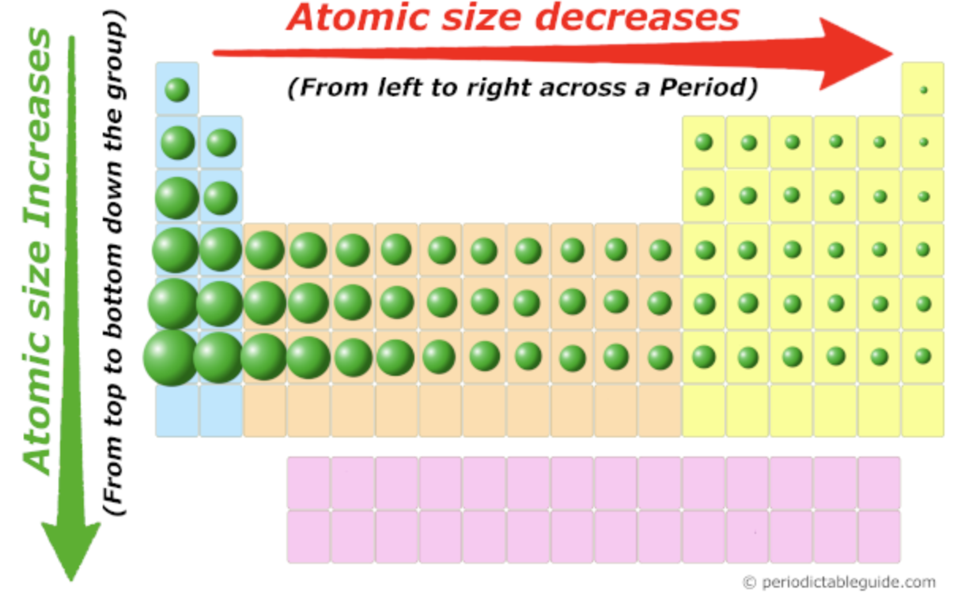
Atomic Radius
PERIODS: left → right across a period
n = const, but Z ↑ → Increase the attraction of nucleus and outermost electrons
Radius decrease left to right
GROUPS: top ⇢ bottom down a group:
Valence electron = const., but n get lager
Radius increase up to down

Slide 23
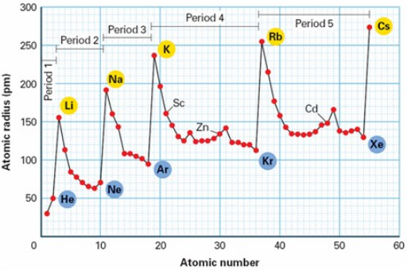
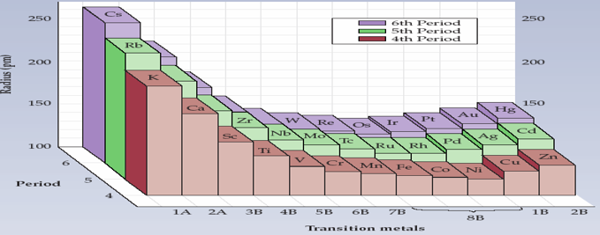
Atomic Radius
In Big Periods (4-7) or B Group: the Atomic Radius slowly change and increase or decrease irregularly
The shrinkage of subshell d and f of d-,f-elements
Nearly the same properties

Slide 24
Atomic Radius
Example 1: Choose the correct statement. Line of atoms: O (Z=8), F(Z=9), Ne (Z=10), Al (Z=13) and S (Z=16) in order of the radius R increase:
A. Al < S < Ne < F < O B. Ne < F < O < S < Al
C. S < Al < O < F < Ne D. O < F < Ne < S < Al
Example 2: Choose the correct statement. Line of atoms Ca (Z = 20), Al (Z = 13), P (Z = 15), K (Z = 19) in order of the radius R increase:
A. P < Al < Ca < K B. P < Al < K < Ca
C. Al < P < K < Ca D. K < Ca < P < Al

Slide 25
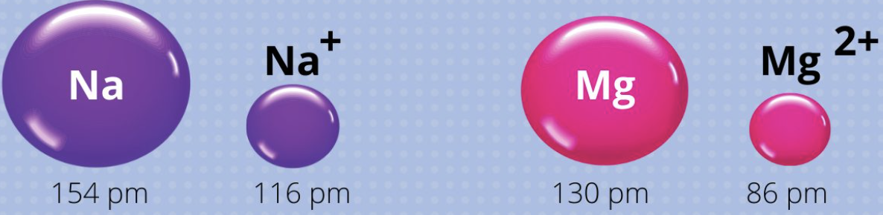
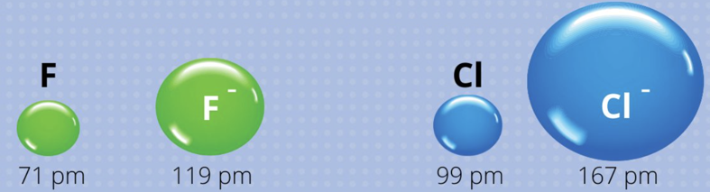
Ionic Radius
Cation (A^{a+}): e⁻ in VE ↓ ⇢ Attraction (e⁻ vs. nucleus) ↑ ⇢ R↓
Anion (B^{b-}): e⁻ in VE ↑ ⇢ Attraction (e⁻ vs. nucleus) ↓ ⇢ R↑
Summary:
r_{(cation)} < r_{(atom)} < r_{(anion)}
In one element:
Fe³⁺ < Fe²⁺
(càng mất càng giảm)

Slide 26
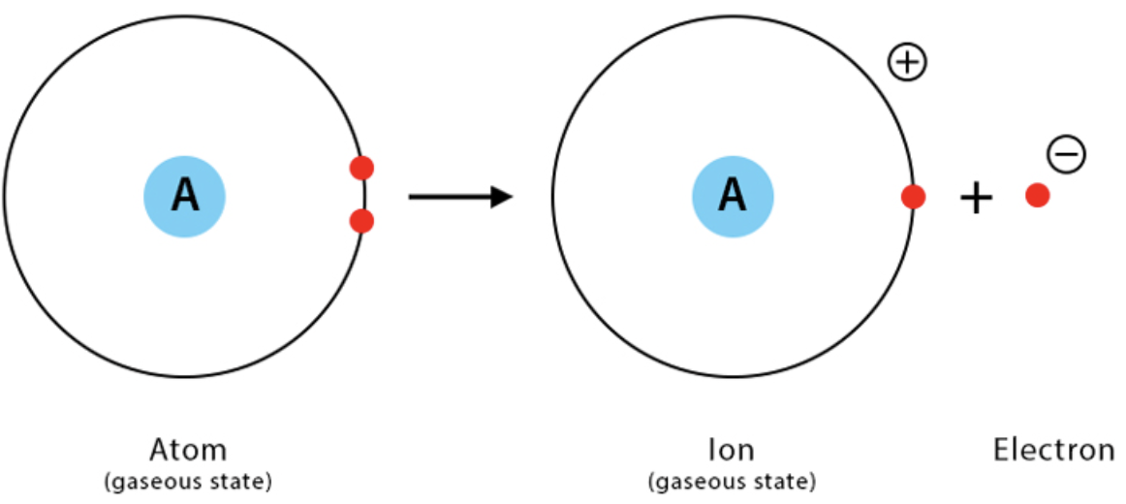
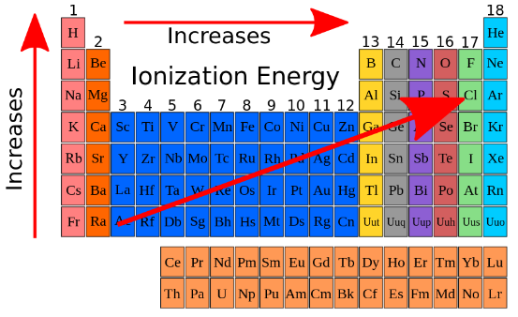
Ionization Energy (I)
IONIZATION ENERGY (IE): is energy necessary to remove an electron to form a positive ion
In multi-electron atom:
First ionization energy (I₁): energy to remove first electron from an atom
Second ionization energy (I₂): energy to remove second electron from an ion⁺¹
I₁ < I₂ < I₃ < … < I_{n}
Ionization in metals and non-metals
Metals: electrons easily removed → Low value
Non-metals: electrons difficult to remove → High value

Slide 27
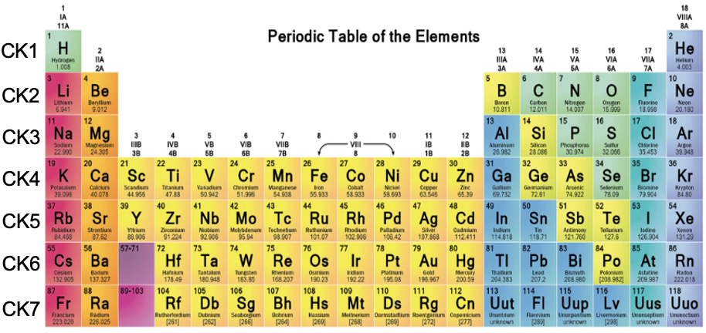
Ionization Energy (I)
Ionization Energy Increase
The trends of IE is opposite that of atomic radius.
In Big Periods (4-7) or B Group: the IE slowly change and increase or decrease irregularly
Noble gases has 1s² or ns²np⁶ → the most stable → the highest IE
Atomic Radius Increase

Slide 28
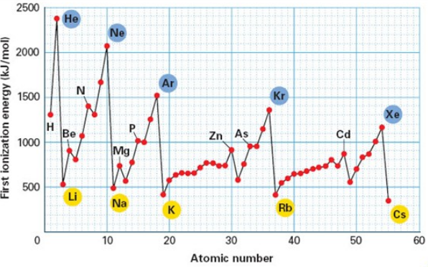
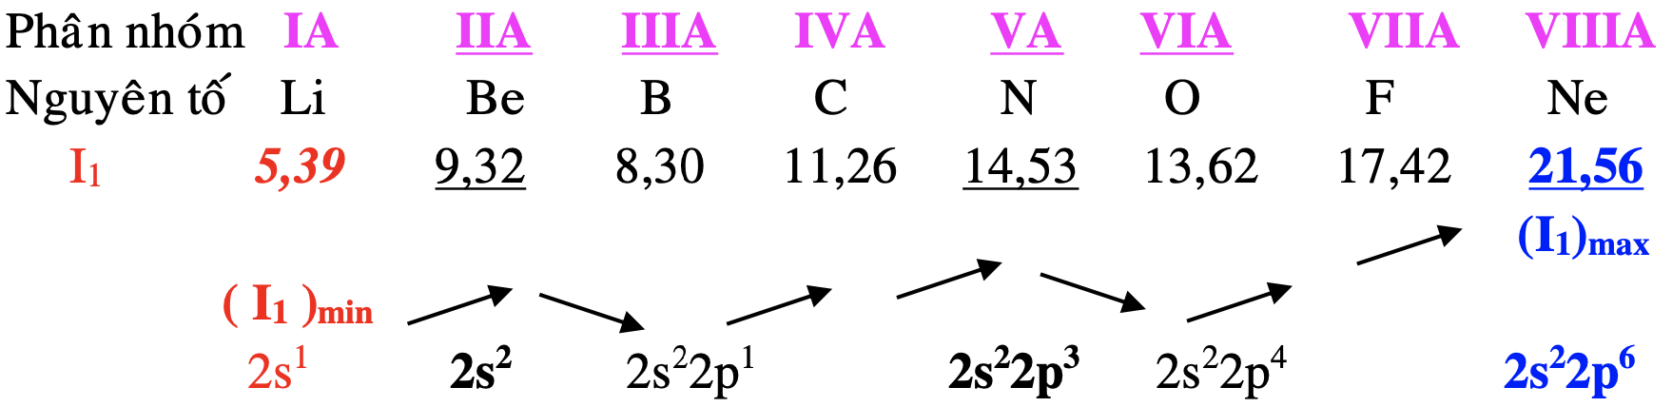
Ionization Energy (I)
Elements has semi-saturated or saturated configuration (s², p³, p⁶) ⇢ stable ⇢ I↑
Groups
Elements
Note:
P.2: B (2s²2p¹) < Be (2s²) < O (2s²2p⁴) < N (2s²2p³)
P.3: Al (3s²3p¹) < Mg (3s²) < S (3s²3p⁴) < P (3s²3p³)

Slide 29
Ionization Energy (I)
Example 1: Choose the correct statement. Line of atoms: Na (z=11), Mg(z=12), Al (z=13), P (z=15) and S (z=16) in order of the increase of the first ionization energy (I₁):
A. Na < Mg < Al < P < S B. S < P < Al < Mg < Na
C. Na < Al < Mg < P < S D. Na < Al < Mg < S < P
Example 2: Choose the correct circumstance. The first ionization energy (I₁) of these atoms with electron configurations 1s²2s²2p⁴ (1), 1s²2s²2p³ (2), 1s²2s²2p⁶ (3) and 1s²2s²2p⁶3s¹ (4) increase in the direction of:
A. 1 → 2 → 3 → 4 B. 3 → 2 → 1 → 4
C. 4 → 1 → 2 → 3 D. 4 → 3 → 2 → 1

Slide 30
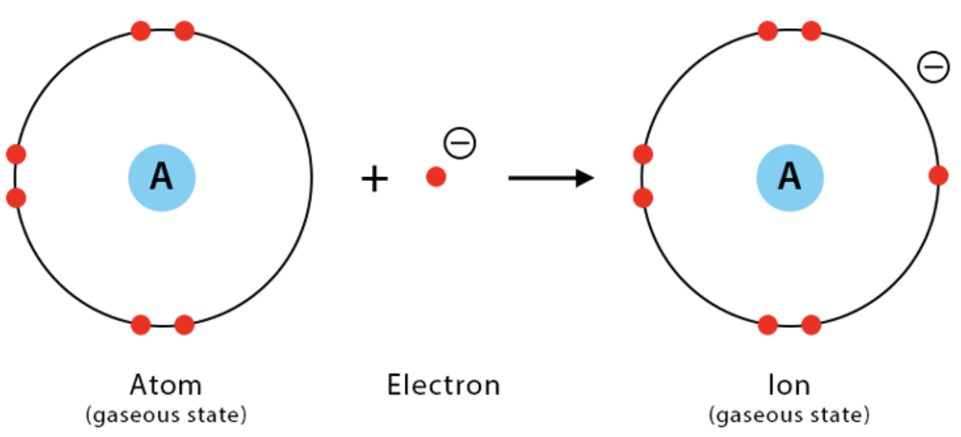
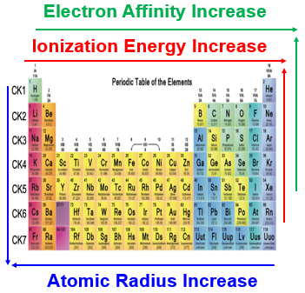
Electron Affinity (E_{a})
Definition: is the energy released (negative value) or received (positive value) when atom combine an electron into ion gas without any stimulation.
Periods: Left → Right
n = const., but Z ↑ → Increase the electrostatic attraction → EA ↑
Groups: Up → Down
n and R ↑ → Decrease the electrostatic attraction → EA ↓

Slide 31
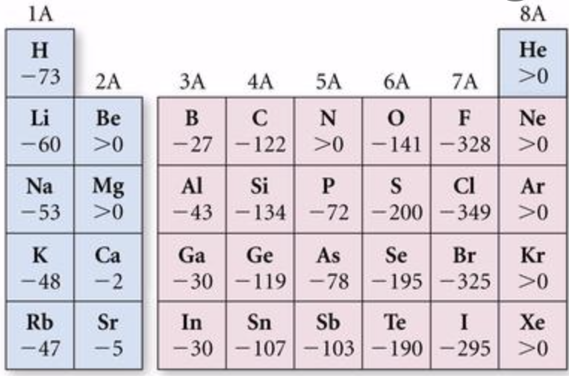
Electron Affinity (E_{a})
Note:
Electron Affinity Increase
When comparing E_{a} of elements, the E_{a} value is taken as absolute value.
ns²
ns²np³
EA is low with elements having stable electron configuration.
IIA (ns²)
VA (ns²np³)
Inert gases (ns²np⁶)
ns²np⁶
Affinity in metals and non-metals
Metals: electrons difficult to accept → Low value
Non-metals: electrons easy to accept → High value

Slide 32
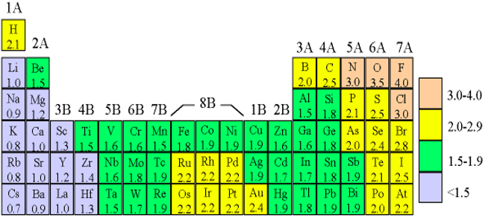
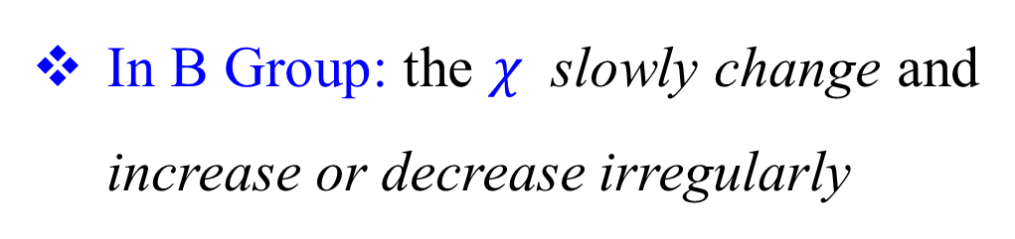
Electronegativity ($χ$)
Definition: is a chemical property that describes the tendency of an atom to attract electrons toward itself
Same trends as ionization energy and electron affinity trends, but opposite to atomic radius trends.
Electronegativity Increase
7A group has the largest electronegativity in the periodic table
In B Group: the $χ$ slowly change and increase or decrease irregularly
Atomic Radius Increase

Slide 33
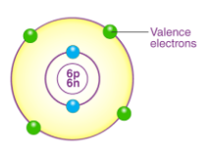
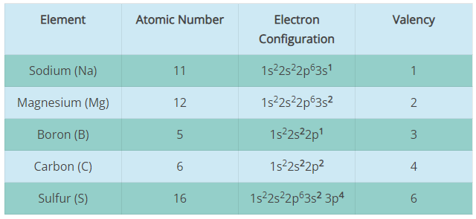
Valency and Oxidation Number
VALENCY: is the No. of electrons present in the outermost shell of a particular element
Does not indicate the electrical charge of an atom in a compound;
Determines the maximum number of bonds that an atom can have.

Slide 34
Metal and Non-metal Determination
Based on the number of valence electrons (VEs):
VEs = 1, 2, 3 ⇢ Metal
Ex.: K (19): 4s¹, Al (13): 2s²2p¹
VEs = 5, 6, 7 ⇢ Non-metal
Ex.: O (8): 2s²2p⁴, Cl (17): 3s²2p⁵
Small Periods: Non-metal
Ex.: C (6): 2s²2p²
VEs = 4
Big Periods: Metal
Ex.: Sn (50): 5s²5p²

Slide 35
Valency and Oxidation Number
OXIDATION NUMBER: is the number of electrons that a particular atom can lose, gain or share with another atom
Indicate the electrical charge of an atom in a compound;
Does not indicate the bonds that a particular atom can have.
Highest Positive Oxidation Number = Group Number
Example: Na¹⁺ (1A); Mn⁷⁺ (7B); N⁺⁵ (5A)
Exception 1B, 8A&B
Lowest Negative Oxidation Number = Group Number - 8
Example: N³⁻ (5A); O²⁻ (6A); Cl⁻¹ (7A)

Slide 36
Valency and Oxidation Number
SOME WAYS TO DETERMINE OXIDATION NUMBER
The oxidation state of an element is always zero
Example: Mg⁰ ; Na⁰; H₂⁰
2. The oxidation state of
Group 1A (Alkaline metals) = +1 Ex: Na⁺, Li⁺, …
Group 2A (Alkaline earth metal) = +2 Ex: Ca²⁺, Ba²⁺, …
Hydrogen (H) = +1 Exception hydride compound (NaH, CaH₂, …)
Oxygen (O) = -2 Exception (H₂O₂, F₂O, …)
3. Total oxidation number in neutral molecule of elements = 0
+1
+7
-2
Example: KMnO₄ (1+7-2*4=0)

